Slide 1

OurBank Churn Predition
OVAIS KHAN
CAPSTONE PROJECT
PART 1: TOPIC PROPOSAL AND DATASET

Slide 2
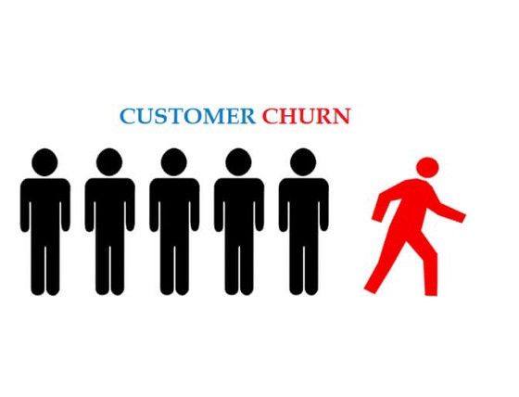
Project Brief
Client Introduction & Problem Statement
Credit Cards Department of OurBank - Australian retail bank with the largest branch and ATM networks.
OurBank offers four types of credit cards.
Blue,
Silver,
Gold,
Platinum
Management team is concerned with Customers attrition, as it costs, 5 times the revenue more to bring them back or to get new clients, then to retain existing ones, proactively.

Slide 3
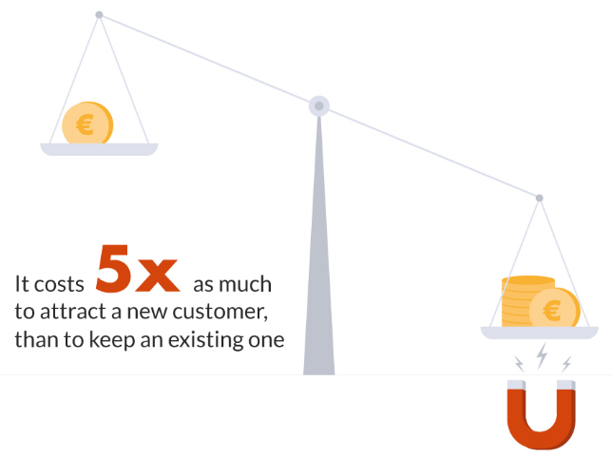
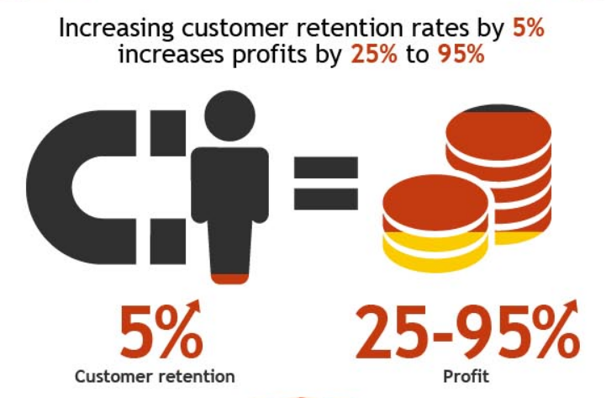
Financial Impacts Retain Existing vs Getting New

Slide 4
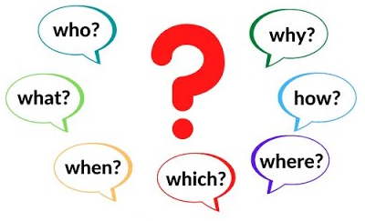
The Big Question
WHO HAS LEFT AND WHY DID THEY LEAVE
Can we classify with reasonable certainty, the profile of customers, who have churned, into a specific category, based on shared and similar characteristics, that holds true for most of the customers in that category?
Can we identify some of the rationale, that are possibly the potential reasons behind, why these customers would have left, given the data by the client?

Slide 5





Project Objectives & Goals
Learn from past customer behavior, and identify main triggers and factors that led to churn and understand which customers are staying and why? We will target for 3 three high correlation attributes
Predict which of existing customer base are risk, using Machine Learning models, that will allow services team to be creative and proactive in their engagement with the customer.
- Linear (Logistic Regression or SVM
- Non Linear (Random Forrest or XGBoost)
SUMMARIZED GOALS AND METRICS
Evaluate models accuracy and performance. We will start off with 80% accuracy and see if further improvements can be made
Recommend strategies that can retain customers and provide insights into why they leave.

Slide 6
Approach to Solving the problem
Understanding the Data
Data Cleaning and General or Summarized EDA on overall dataset.
Detailed EDA
Machine Learning Model
Detailed EDA on each factor individually and its relation to churn. For e.g. which card category had more churn, or which income level had more churn
Prepare data for ML and Run a Logistic Regression Model to predict customers at risk of churn.
Model Evaluation
Evaluate and improve model score if required and understand the factors / features that contribute most to the score.
Ranked List of Customers at Risk of Churn
Recommendations, Insights and Visualizations.
Recommend strategies that can retain customers and provide insights into why they leave.
Define a mechanism to rank the predicted list of customers, such as for e.g. by card category Platinum to gold,..

Slide 7
Assumptions and Dataset Limitations
Some other data with information on Data on Customer services, additional products, digital transformation and convenience to customers, would have aided in understanding customer churn patterns a bit better.
Churn is defined as the customer's closure of credit cards and not that, the client has been inactive for a given period or decline of assets base by more then 50% even when the client has been active (but this might be due to clients needs for e.g. if they need a down payment for the house) or that they might have closed one credit card but still hold other products.
Another issue with the prediction is, how far out you want to predict. If its too far out then it might be less accurate and if the time horizon is too short, then it might be too late to intervene as the customer might have already made the mind up.
Although the customers are categorized as Attired, yet they still showing balance in their account
Further the balance seem to be a total balance at the time of Attrition, whereas it would have been better, to have balances over a period of time as opposed to a single date to ascertain trends.

